Slide 1
Polynomial Curve Fitting

Slide 2

Contents
1. Introduction
2. Genetic Code
3. Mutation
4. Crossover
5. Fitness
6. Selection
7. Observations & Analyses

Slide 3


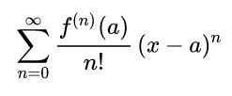

1. Introduction
Principle:
In mathematics, a Taylor series is a representation of a function as an infinite sum of terms that are calculated from the values of the function’s derivatives at a single point. A function can be approximated by using a finite number of terms of its Taylor series.

Slide 4
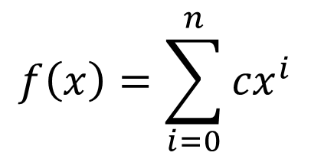
1. Introduction
The goal of this project is to use genetic algorithm to find a set of coefficients for a polynomial function which fits a series of given data well.
$$f\left(x\right)=\sum_{i=0}^{n}{{cx}^{i}}$$

Slide 5
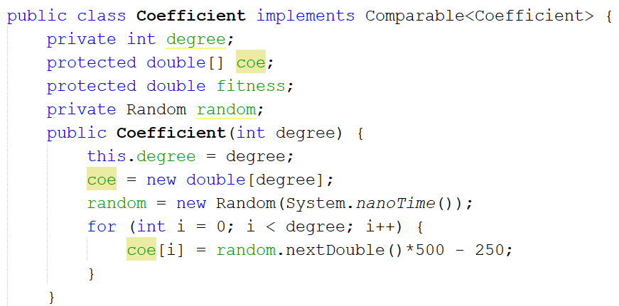
2. Genetic Code
Genotype:
A double array of coefficients.
The index of coefficient is equivalent to each term's degree.

Slide 6
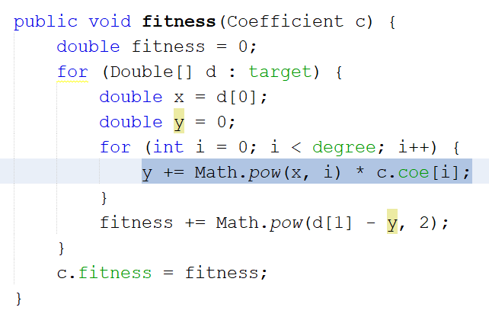
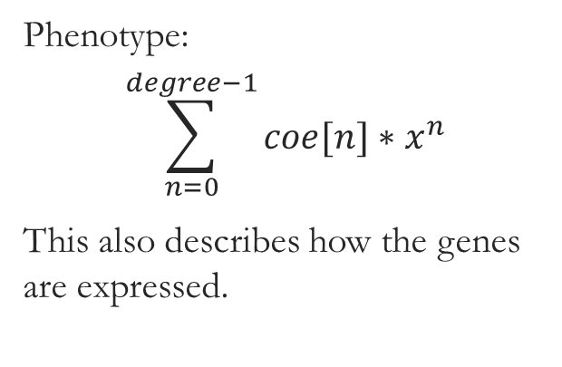
2. Genetic Code
Gene Expression:
Phenotype:
$$\sum_{n=0}^{degree−1}{coe[n]∗x^{n}}$$
This also describes how the genes are expressed.

Slide 7
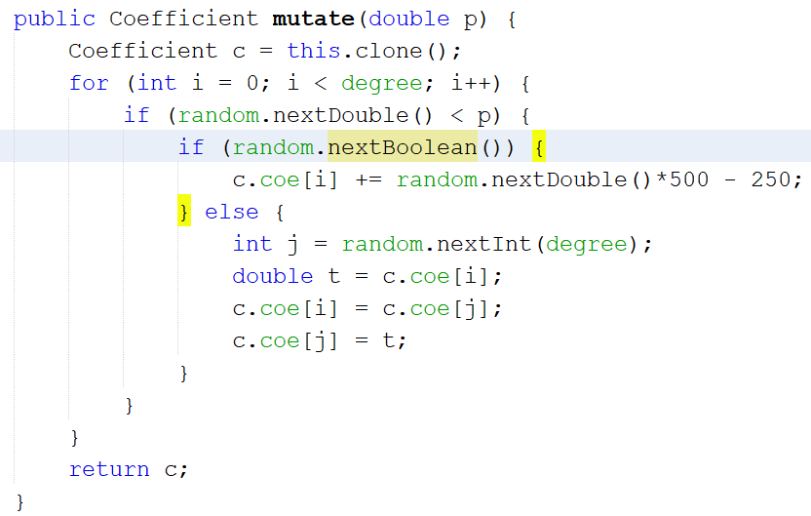
3. Mutation
Mutation rate: p
Option 1: change coefficient value
Option 2: swap two coefficients

Slide 8
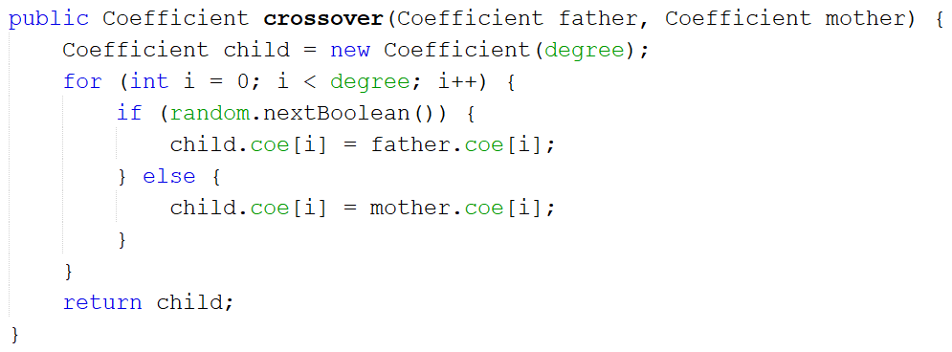
4. Crossover
For each gene/coefficient, a child inherits father’s or mother’s with equal possibility.

Slide 9
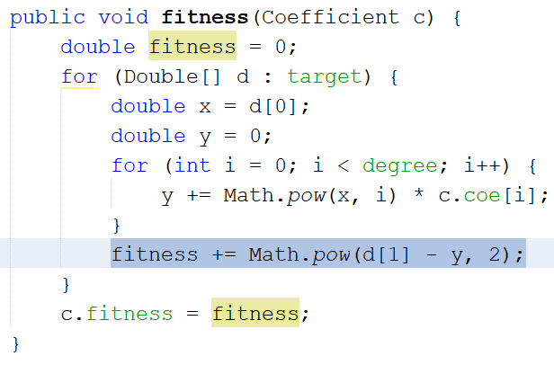
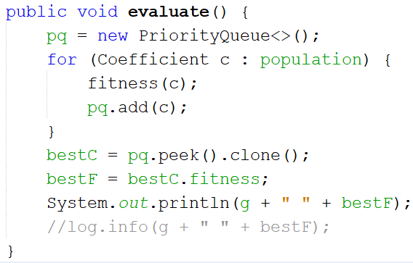
5. Fitness
Using the method of least squares, the difference between the calculated value and the actual value on the Y axis is compared and added point by point. Therefore, the larger the differences, the higher the value of fitness would be. In each population, which is implemented by a priority queue, the top one is the best with the smallest fitness value.

Slide 10
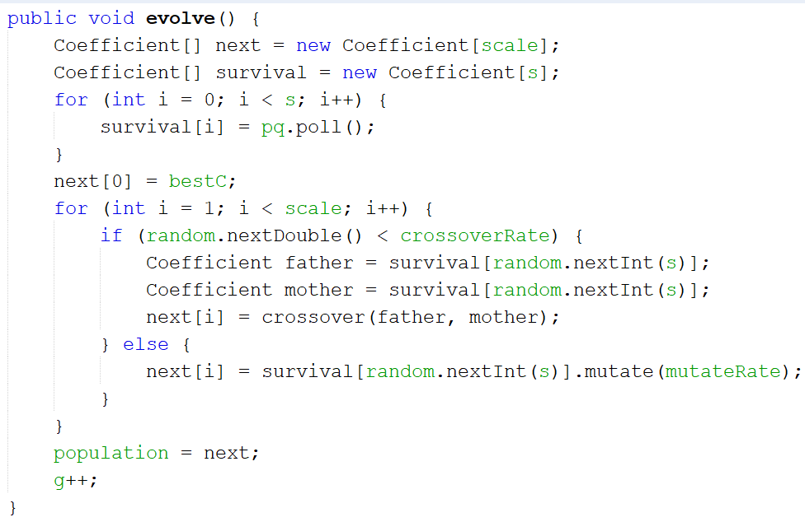
6. Selection
During each generation, the fittest one will be directly copied into the next generation. And the next generation’s population size will continue increasing either by crossing over two randomly selected survivors’ genes or mutating a survivor’s genes until it reaches the predefined scale.

Slide 11



7. Observations & Analyses

Slide 12
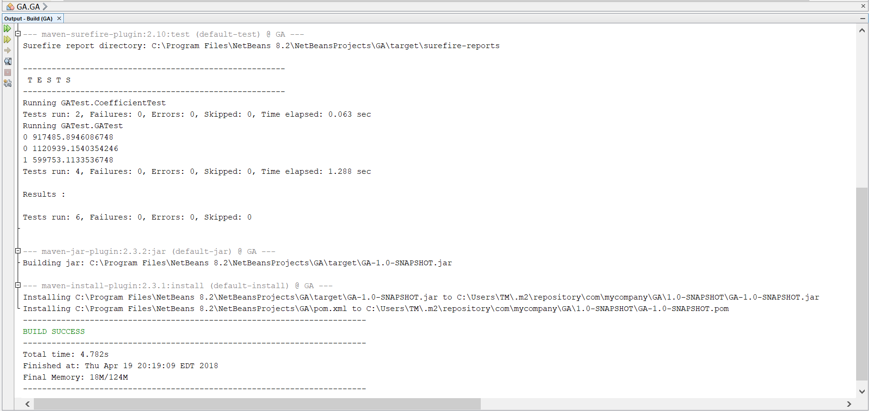
Unit Tests

Slide 13
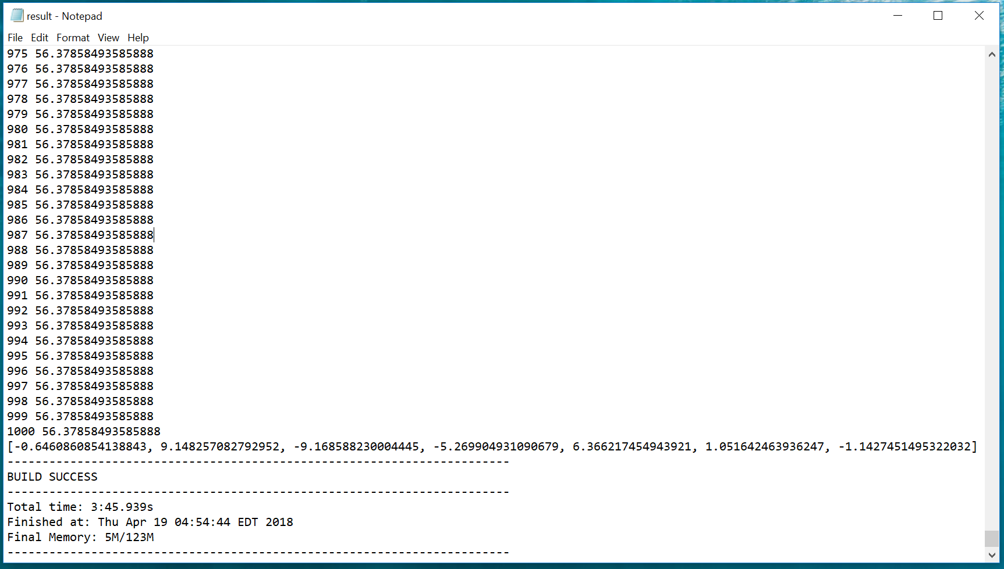
Output
generation
Difference/Fitness
Fittest coefficients

Slide 14
Output Analysis

Slide 15
Output Analysis

Slide 16
Fitting function
Original data

Slide 17
Thanks

